Slide 1
PROJECT
Linux Kernel Netfilter
Code Analysis and Improvement
Performance Optimization by Resolving Connection Tracking Lock Contention
Team 3

Slide 2
Contents
1.
Project Overview
8.
Improvement 1: Dynamic Spinlock
2.
Netfilter Architecture
9.
Improvement 2: Per-Bucket Lock
3.
Packet Processing Flow
10.
Performance Analysis Environment
4.
nf_hook_slow Analysis
11.
Results: Dynamic Spinlock
5.
Connection Tracking Overview
12.
Results: Per-Bucket Lock
6.
Processing Existing & New Connections
13.
Result Comparison & Analysis
14.
Conclusion
7.
Problem: Lock Contention

Slide 3



Project Overview
Key Contributions:
Research Background
Analysis : Detailed analysis of the NF_HOOK → nft_do_chain path and the existing/new connection processing mechanism in nf_conntrack_in.
In high-load environments, accessing the nf_conntrack hash table causes network throughput degradation due to lock contention.
Need to analyze the bottleneck of the existing global lock array method.
Improvement 1 : Implemented dynamic lock array allocation based on CPU count and hash table size.
Research Goal:
Improvement2 : Implemented dedicated locks for each hash bucket to distribute contention.
Detailed analysis of the Netfilter/Connection Tracking code path.
Improve performance in high-load environments by minimizing lock contention.
Evaluation : Quantitative performance measurement using perf and comparative analysis of the two methods.

Slide 4
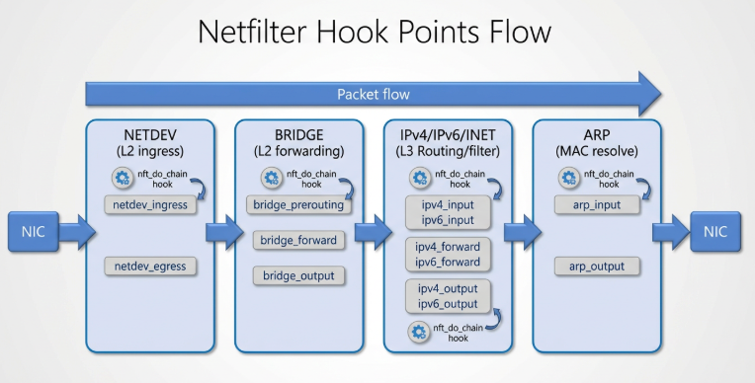
Netfilter Architecture
What is Netfilter?
A packet control framework inside the Linux kernel network stack.
Intercepts and controls traffic by placing Hooks on the main paths where packets travel.
Key Operating Principles:
Hooking: Intercepting packets at key points.
Verdict: Executes registered handler functions and decides the packet's fate (e.g., ACCEPT, DROP).
Relation to Connection Tracking
The Connection Tracking system is a state management module that operates by registering at these Netfilter hook points.

Slide 5
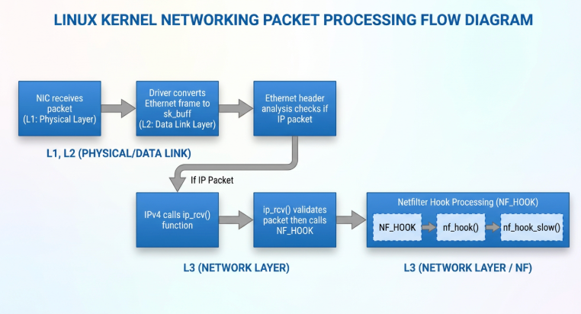
Packet Processing Flow :
NIC → ip_rcv() → NF_HOOK
NIC Receive (L1):
Network card receives packets from outside (Physical layer).
2. sk_buff Conversion (L2)
Driver converts Ethernet frame to sk_buff structure.
3. Header Analysis
Analyzes Ethernet header to identify IP packets.
4. ip_rcv() → NF_HOOK
Validates IPv4 packets and calls NF_HOOK
5. Hook Chain Execution
Sequentially executes hook functions: NF_Hook → nf_hook() → nf_hook_slow()

Slide 6
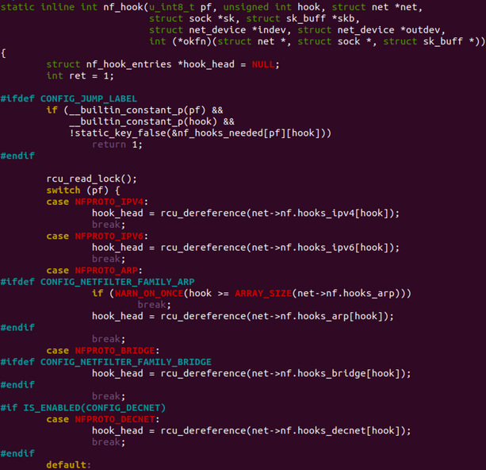
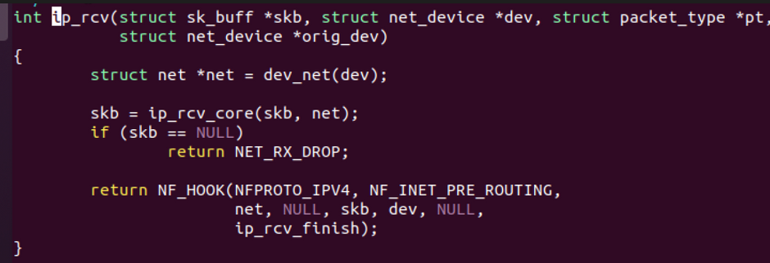
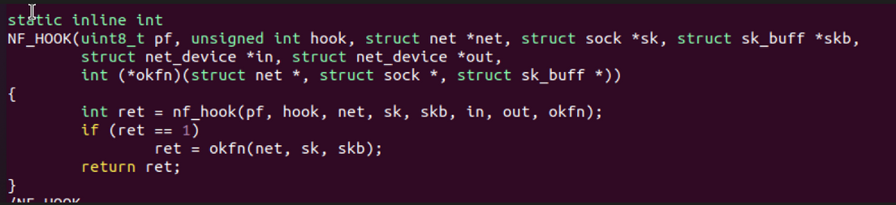
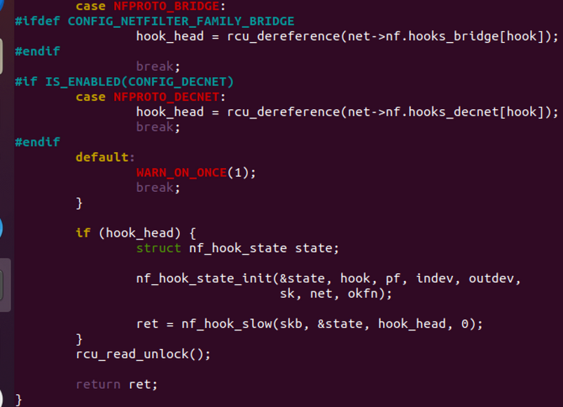
Packet Processing Flow :
NIC → ip_rcv() → NF_HOOK

Slide 7
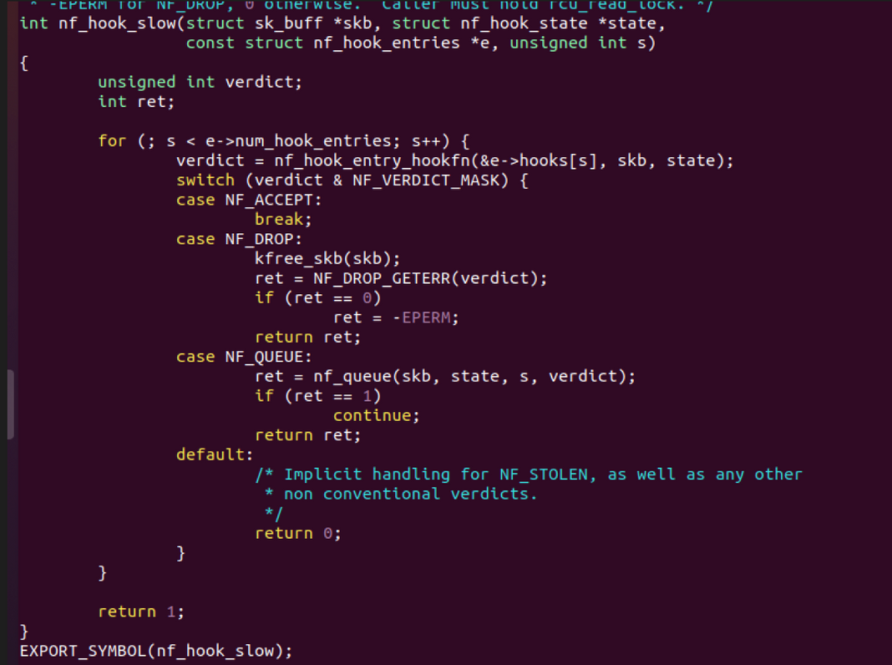
nf_hook_slow() Analysis
Verdict Branching
ACCEPT: Packet allowed
Proceeds to the next hook.
DROP: Packet discarded
Memory freed via kfree_skb(). Function exits immediately (subsequent hooks not executed).
QUEUE: Sent to user space
Handled by NFQUEUE system via nf_queue().
DEFAULT
Exception handling for undefined verdicts.

Slide 8
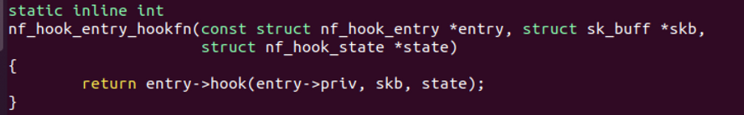
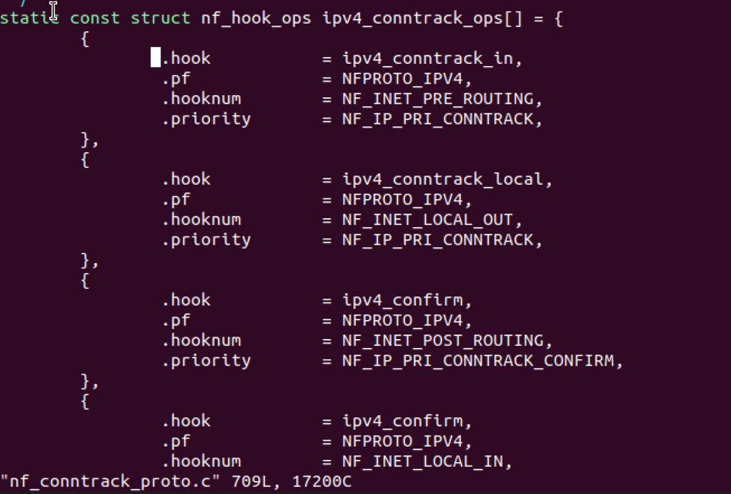
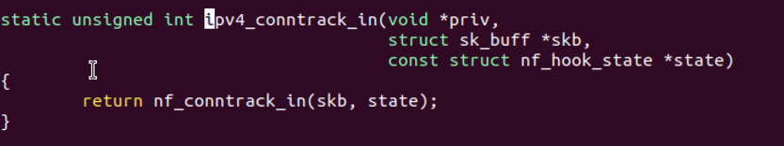
Analysis after nf_hook_slow()

Slide 9
Connection Tracking Overview
nf_conntrack_in()
Key Processing Steps
Extract Connection Tuple from Socket Buffer (skb)
Core Role:
The entry point for Connection Tracking in Netfilter.
Checks if a packet belongs to an existing connection and manages its state.
(Source/Destination IP/Port, Protocol)
2.Search for Existing Connection in Hash Table
Key Features:
__nf_conntrack_find_get
Tuple-based Identification: Uses 5-tuple (Source IP/Port, Dest IP/Port, Protocol).
Hash Table Search: Calculates hash using hash_conntrack_raw() and searches buckets.
RCU Concurrency Control: Read operations are protected by RCU to minimize lock overhead.
Protocol-specific Processing: Handles TCP state machine, UDP timeouts, etc.
3.If Existing: Update State & Return; If New: Create & Validate Protocol
4.Process Packet based on Protocol & Return Result
TCP/UDP/ICMP, etc.
5.Confirm and Insert into Table at Confirm Hook
__nf_conntrack_confirm

Slide 10
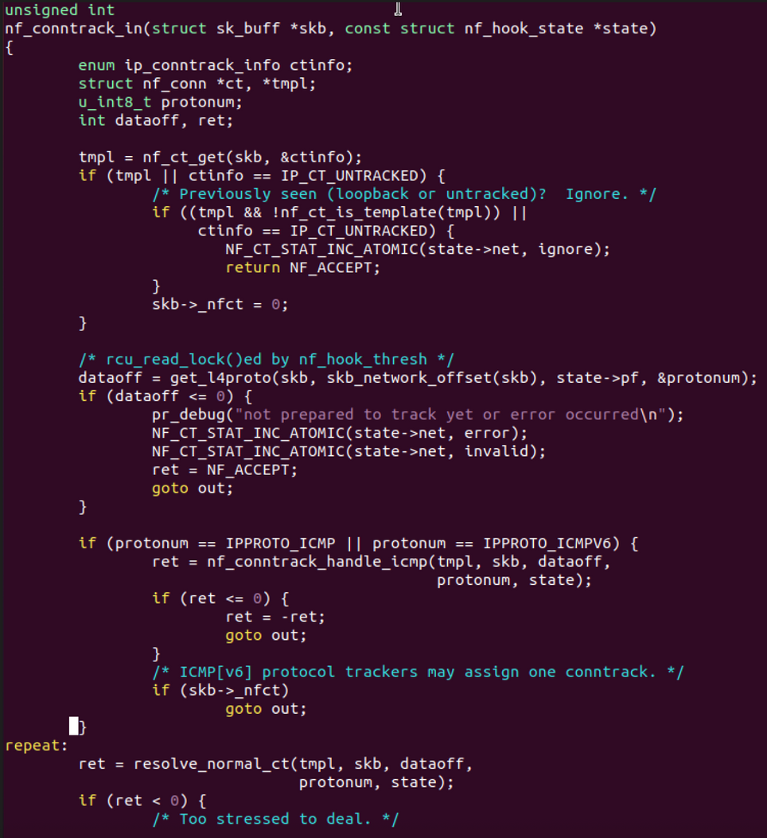
Connection Tracking Overview
1
Duplicate/Exception Handling
Checks if a connection object is already attached to the packet (skb) using nf_ct_get (e.g., loopback). If present, it passes immediately.
2
L4 Protocol Parsing
Extracts the Layer 4 protocol number (protonum, e.g., TCP, UDP) and data offset (dataoff) from the packet header
3
ICMP separate processing
Since ICMP packets are control messages, they are handled by a separate function (handle_icmp) (e.g., checking if an error message is related to an existing connection).
4
Connection Identification
Calls resolve_normal_ct to generate a 5-Tuple and determines whether it is an existing connection by searching (Lookup) the hash table or creating a new one.

Slide 11
Existing Connection Processing (Search Path)
hash_conntrack_raw
Key Function Call Flow
Receives the connection tuple (Source/Dest IP, Port, Protocol) as input, calculates, and returns the hash value.
__nf_conntrack_find
Iterate through buckets corresponding to the hash value.
Check status of each connection (Garbage Collection if expired).
Return the pointer if the connection key matches.
RCU Protection & Bucket Traversal
Uses the RCU (Read-Copy-Update) locking mechanism to safely traverse buckets during concurrent access, ensuring hash table consistency.
__nf_conntrack_find_get
Concurrency Handling
Acquire connection info via nf_ct_tuplehash_to_ctrack().
Increment connection reference count (refcount) by 1.
Key match success → Return connection pointer.
Key mismatch → Restore refcount and continue searching.
Buckets can change dynamically due to RCU structure.
Performs re-lookup if bucket state change is detected.
Allows write operations during read operations.
Search Result
When an existing connection is found, increments the reference count to ensure memory safety and returns the connection pointer to perform state updates.

Slide 12
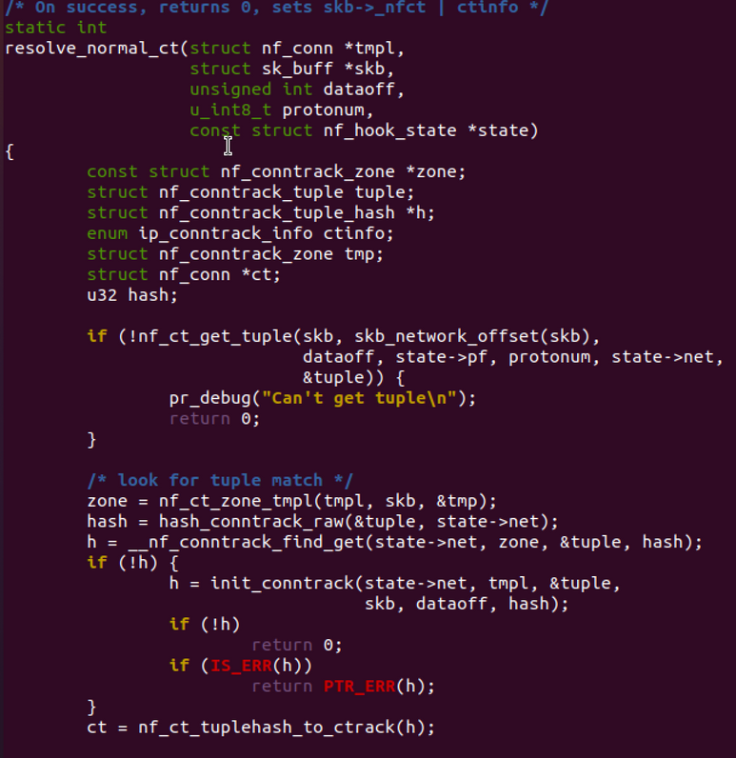
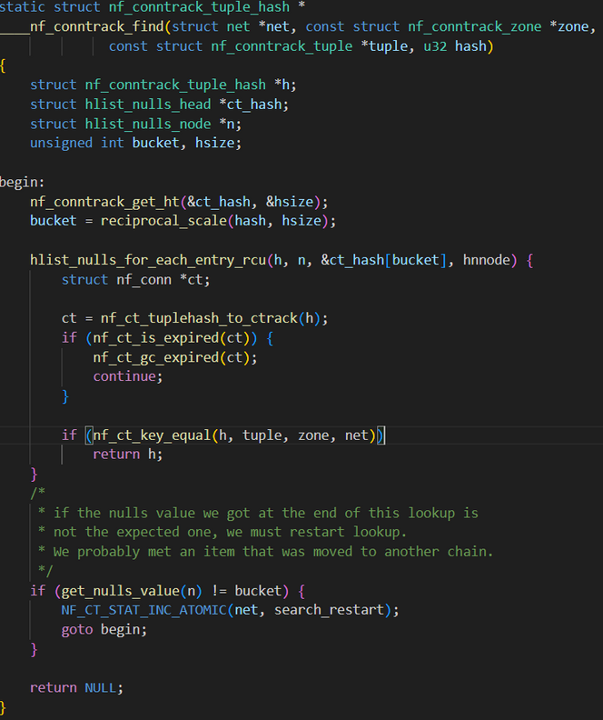
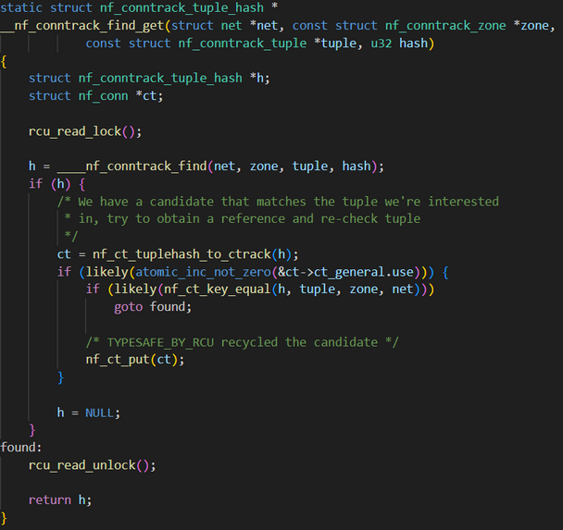
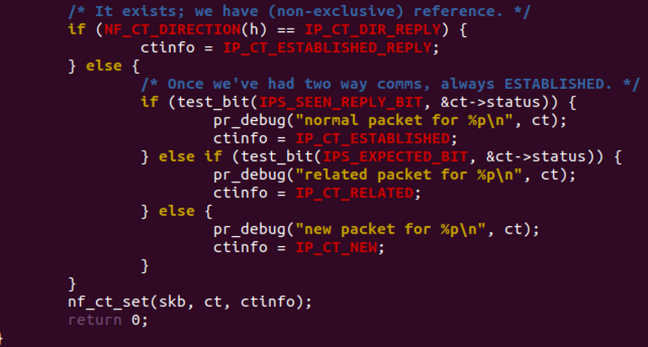
Existing Connection Processing (Search Path)

Slide 13
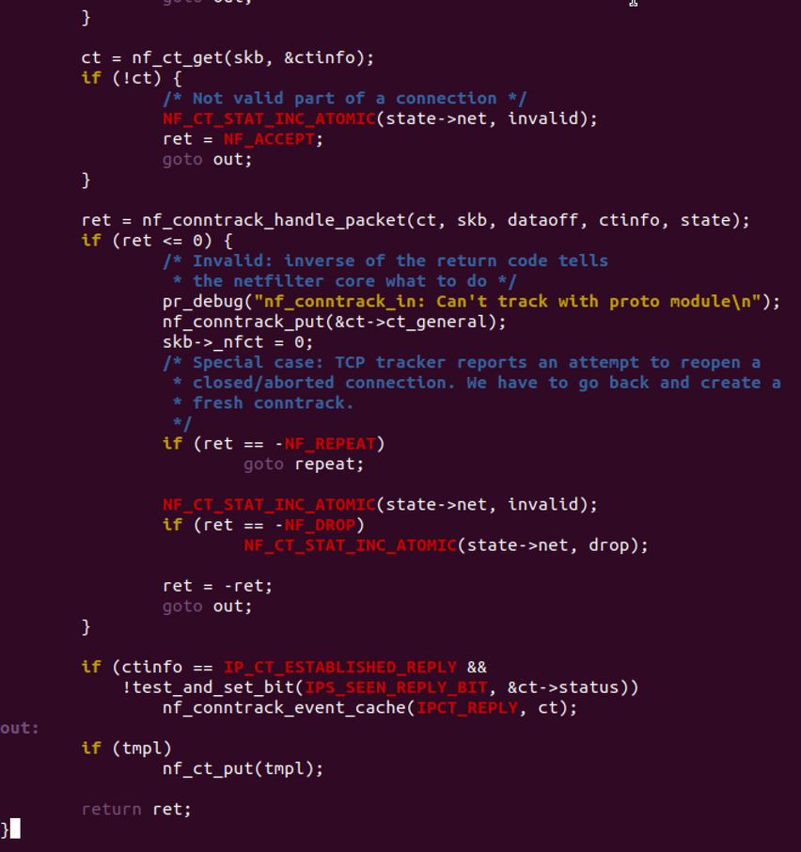
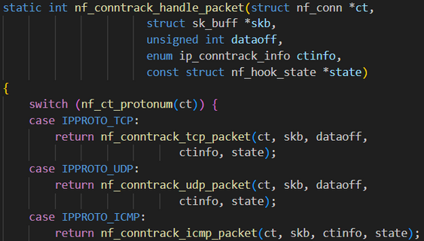
Existing Connection Processing (Search Path)
nf_conntrack_in
Depending on the protocol of the tracked connection, individual functions are called to update the connection information corresponding to the packet.
Each function returns its own packet processing result.
Examples: NF_ACCEPT, NF_DROP, NF_QUEUE
Finally, the nf_conntrack_in() Function Returns the Packet Processing Result

Slide 14
New Connection Processing (Search Path)
When the connection lookup returns NULL, it indicates a new flow, and a new conntrack entry is created

Slide 15
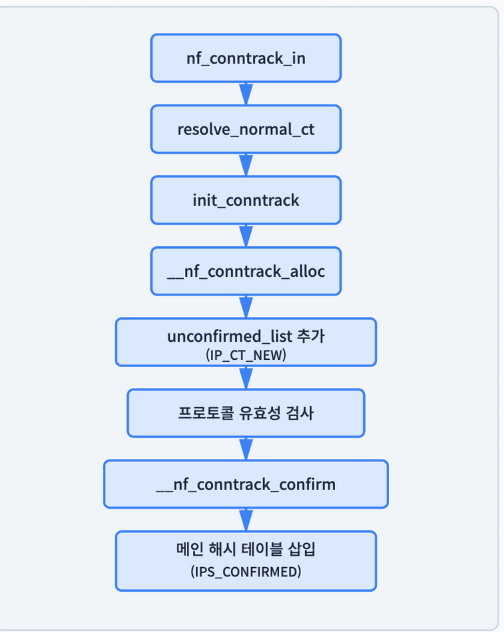
New Connection Processing (Creation & Confirmation)
Creation Stage
Generate reverse tuple → Allocate memory via __nf_conntrack_alloc → Assign memory → Check helper/expectation
Unconfirmed Stage
Add to unconfirmed_list and attach ct to skb (IP_CT_NEW)
Validation Stage
Protocol-specific validity check (e.g., TCP SYN verification)
Confirmation Stage
Lock table using nf_conntrack_double_lock → Remove from unconfirmed list → Insert into hash table → Set IPS_CONFIRMED

Slide 16
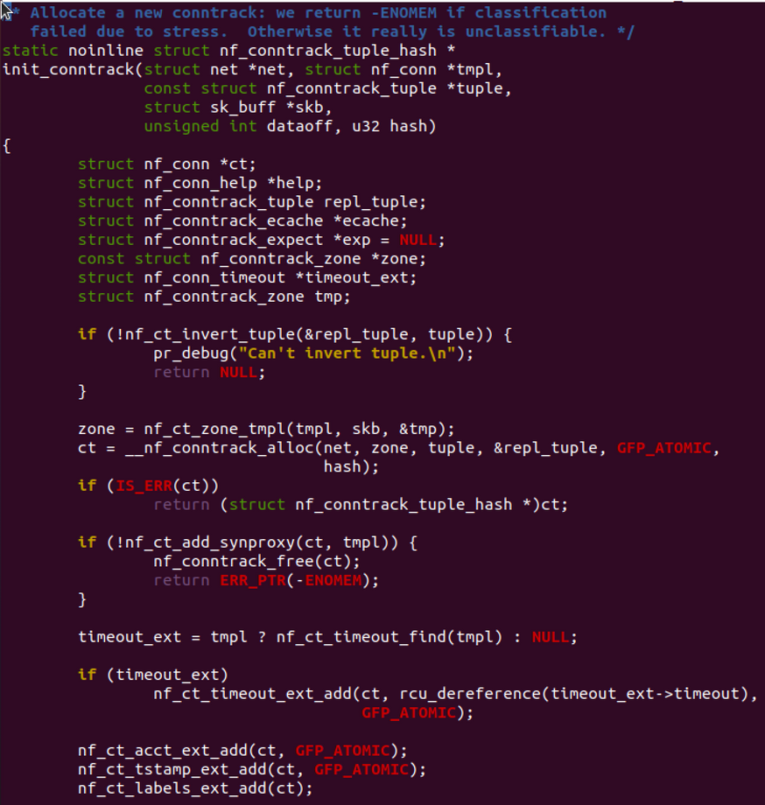
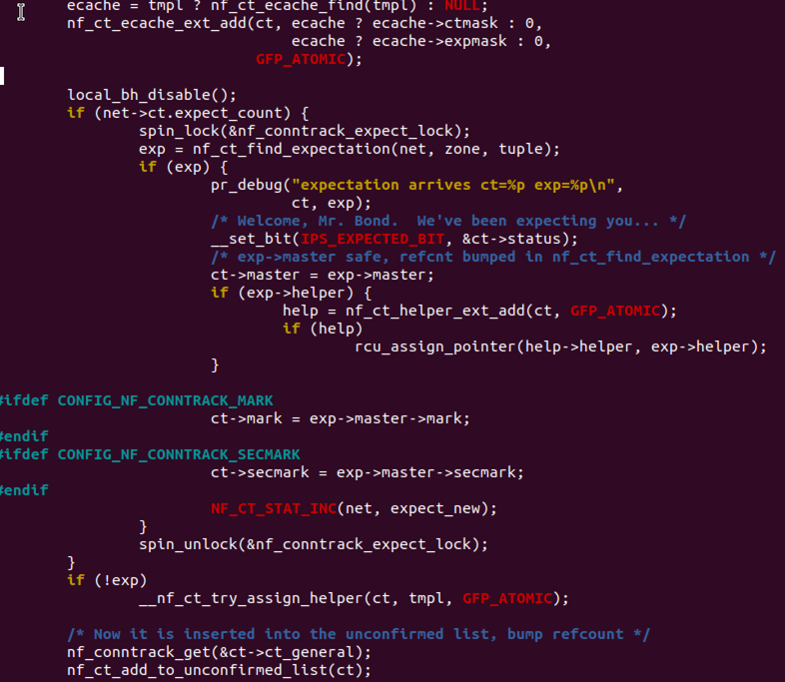
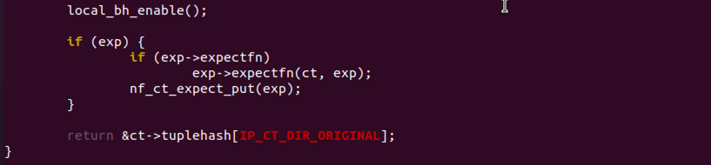
New Connection Processing (Search Path)
Allocate memory for the nf_conn structure by calling __nf_conntrack_alloc.
Temporarily register the entry into the unconfirmed list.

Slide 17
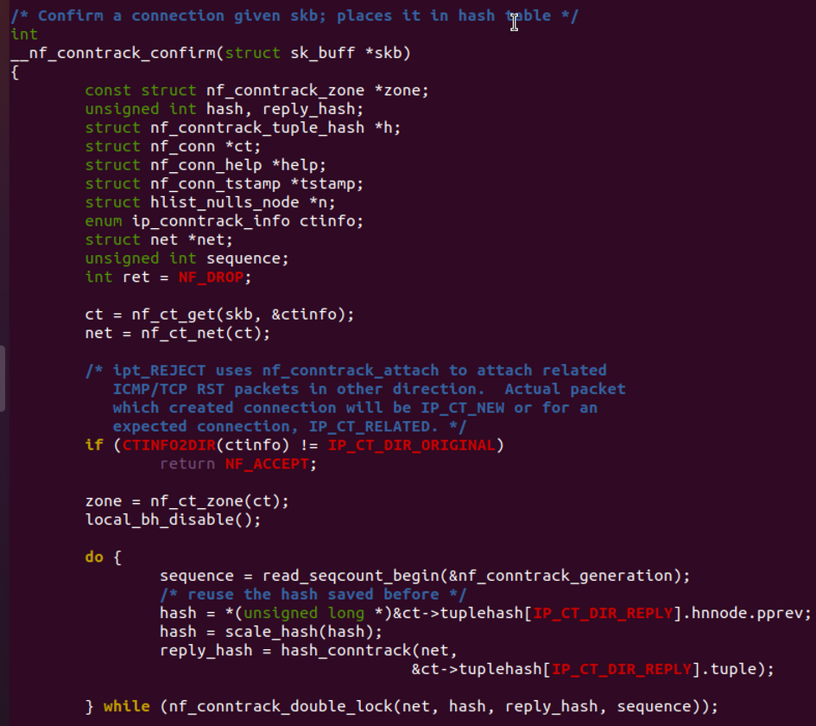
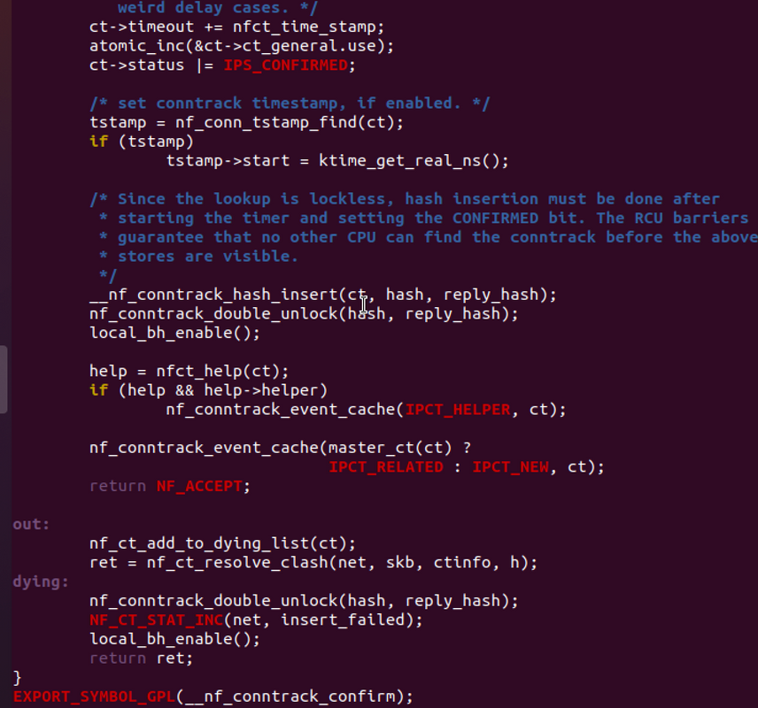
New Connection Processing (Search Path)
Since the global table is shared across all CPUs, concurrent writes can corrupt data — therefore, a lock must be acquired.
Officially insert the entry into the global hash table.

Slide 18
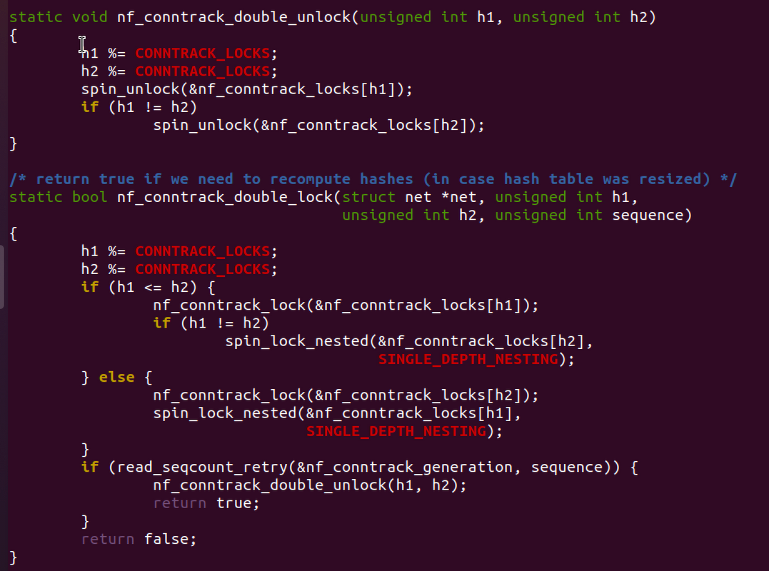
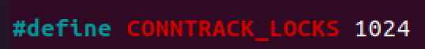
New Connection Processing (Search Path)
nf_conntrack_double_lock

Slide 19
Problem - Intensified Lock Contention
Performance Degradation in Virtualized Environments
Structural Imbalance
(1024 vs 65k)
nf_conntrack_
double_lock
The global shared lock array size is only 1,024.
The actual number of hash buckets is much larger (e.g., 65,536).
1024 vs 65k mismatch causes a structural bottleneck.
When calling __nf_conntrack_confirm or nf_ct_delete,
even different buckets may share the same lock index → unnecessary lock contention occurs.
Prolonged lock spinning increases Host-OS trap frequency,
leading to higher vp_notify overhead → overall system efficiency drops in virtualized environments.

Slide 20
Improvement 1: Dynamic Spinlock Allocation (Concept)
Dynamic Allocation Timing
Optimization Methods
Spinlock arrays are dynamically allocated during the execution of nf_conntrack_init_start().
This removes the limitation of the fixed 1024-lock static allocation.
The lock array size is determined based on the system environment to maximize performance.
Power-of-Two Adjustment
Final lock count is rounded to the nearest power of two for efficient indexing
(use bitwise AND instead of modulo for lock index calculation).
Range Validation
Factors for Determining Lock Count
Ensure the calculated lock array size is within the predefined minimum/maximum range for stability.
CPU-based Calculation : Consider the maximum number of usable CPUs and the number of tasks they can handle. → Allocate 4 locks per CPU.
Hash Table Size-based Calculation : Determine the number of buckets per lock based on the current hash table size. Larger hash tables result in more locks.
Final Decision : Choose the larger value among the two above to ensure sufficient concurrency.
User Parameters
If the user explicitly sets the lock array size:
Validate that it falls within the allowed range and adjust to the nearest power of two if needed.
Efficient Indexing
Implement fast lock selection using: lock_index = hash & (nr_locks - 1)

Slide 21
Improvement 1: Dynamic Spinlock Allocation (Details)
1
Determine Lock Array Size
3
Optimization: Bitwise AND Operation
CPU count: estimate using max_possible_cpus and num_online_cpus
Default: allocate 4 locks per CPU
Determine number of buckets per lock based on hash table size
Adjust the final value to the nearest power of two
(validate within minimum/maximum bounds)
lock_index = hash & (nr_locks - 1)
Power-of-two array size → replace modulo with bit masking
Improves performance when computing lock index from hash values
4
Reallocation on Resize
2
Dynamic Allocation & Initialization
When hash table size changes → free old lock array
Recalculate and reallocate based on the new table size
Replace existing lock structures and pointers accordingly
Allocate lock array memory according to the calculated size
Initialize each lock with spin_lock_init()
Update global lock array pointer and size variables

Slide 22
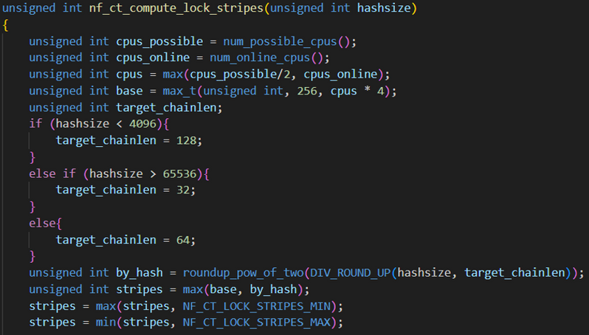
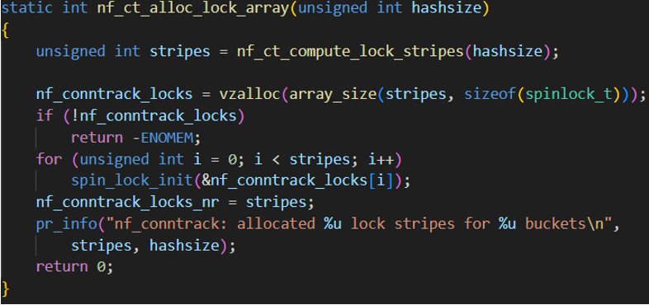
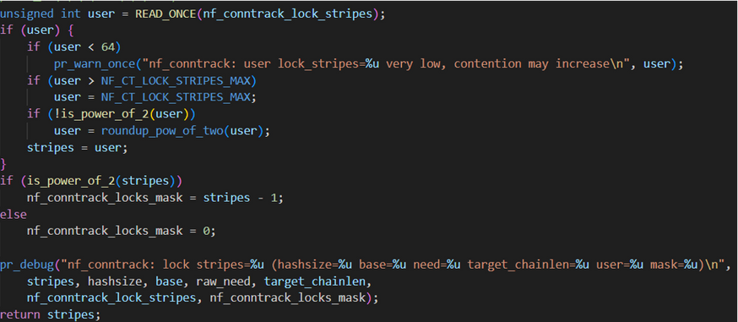
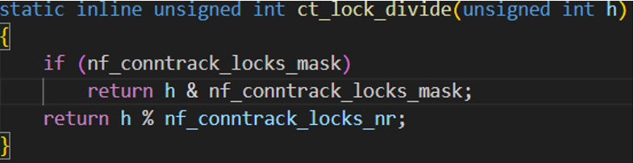
Improvement 1: Dynamic Spinlock Allocation (Details)
Function to allocate the lock array
Leverage power-of-two lock array size to optimize division using bitwise AND
Function to calculate lock array size

Slide 23
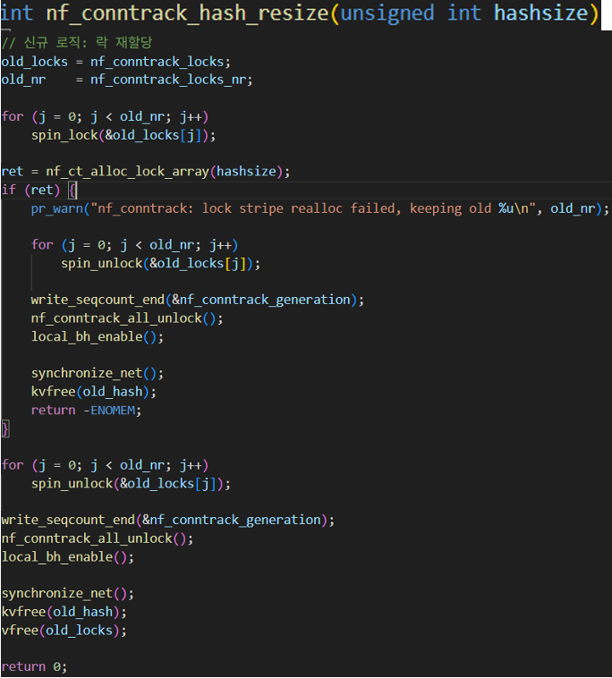
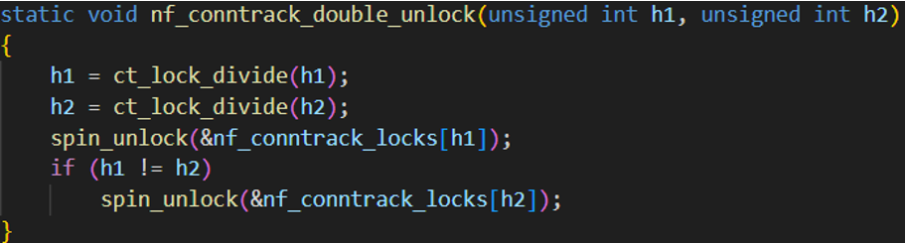
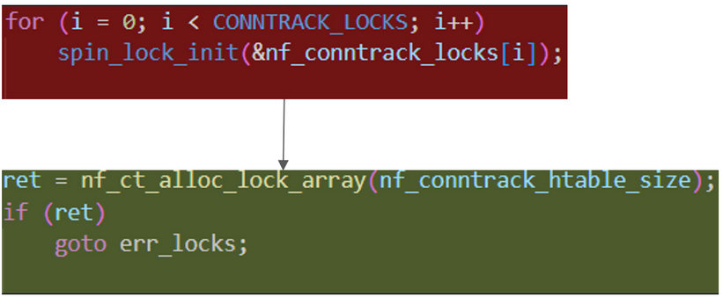
Improvement 1: Dynamic Spinlock Allocation (Details)
Use bitwise AND instead of modulo when deriving lock index from hash values
Modify the hash table resize function accordingly
Replace the static allocation approach with a dynamic allocation approach

Slide 24
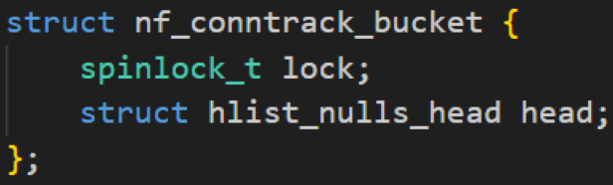
Improvement 2: Per-Bucket Lock Concept
Key Idea
Transition Changes
Assign an independent lock to each hash bucket to distribute lock contention.
Replace the previous global lock array (nf_conntrack_locks, fixed at 1024 locks)
with a structure where each bucket owns its own lock
hlist_nulls_head
nf_conntrack_bucket
Hash table entry type changed to bucket structure
Structural Design
nf_conntrack_locks
nf_conntrack_hash_lock
New structure nf_conntrack_bucket:
Lock is now managed per bucket, instead of globally
nf_conntrack_hash
nf_conntrack_hash_head
Access hash table through bucket’s head
Each bucket manages its head (list) and lock (spinlock) together,
enabling isolated and fine-grained concurrency control

Slide 25
Improvement 2: Per-Bucket Lock Details
Core Change : Remove the global lock array (nf_conntrack_locks) → each bucket owns its own lock → lock contention distributed, concurrency improved, scalability enhanced
1
nf_conntrack_core.c
3
nf_conntrack_netlink.c
Remove global lock array initialization
Define nf_conntrack_bucket and manage both head & lock together
Update ct_hash pointer type: hlist_nulls_head* → nf_conntrack_bucket*
Use bucket.lock for insert/delete/lookup operations
Remove previous lock initialization logic
Replace lock usage: nf_conntrack_locks → bucket.lock
Change list type: hlist_nulls_head → nf_conntrack_bucket
When accessing hash table, use .head member in bucket
2
nf_conntrack.h
4
nf_conntrack_standalone.c
Replace hlist_nulls_head with nf_conntrack_bucket: update table element type
Add structure definition reference for bucket-based table
Same lock model update: use bucket.lock
Same list type change: use bucket structure instead of head list
Access .head for hash lookup operations

Slide 26
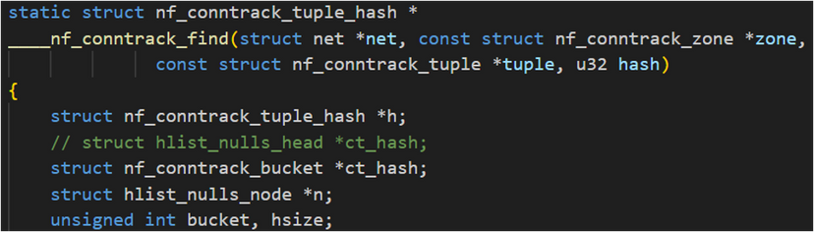
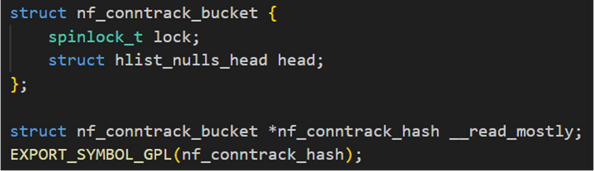
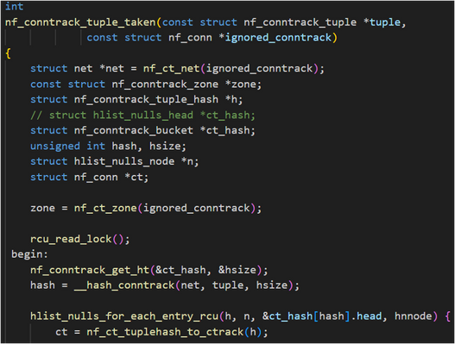
Improvement 2: Per-Bucket Lock Details
Newly define the nf_conntrack_bucket structure.
Update the type of ct_hash pointer from hlist_nulls_head to nf_conntrack_bucket.

Slide 27
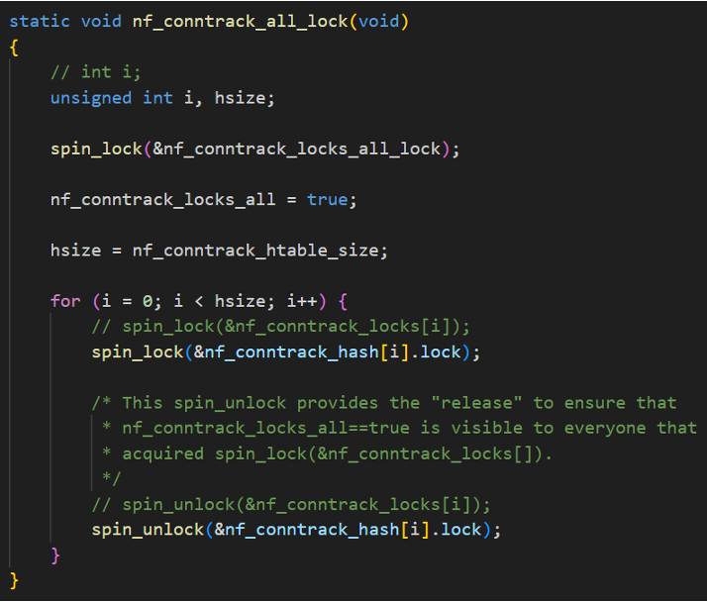
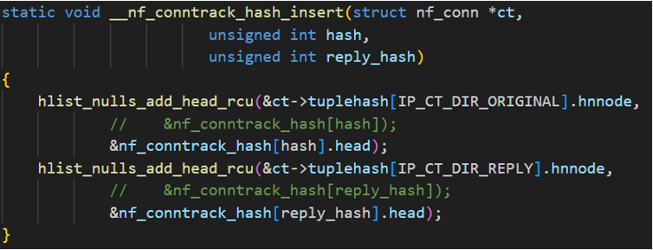
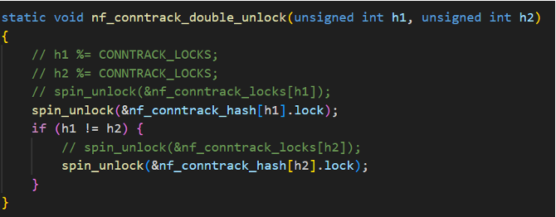
Improvement 2: Per-Bucket Lock Details
Replace previous lock access:
nf_conntrack_locks → nf_conntrack_hash.lock (per-bucket lock)
Replace previous hash head access:
nf_conntrack_hash → nf_conntrack_hash.head

Slide 28
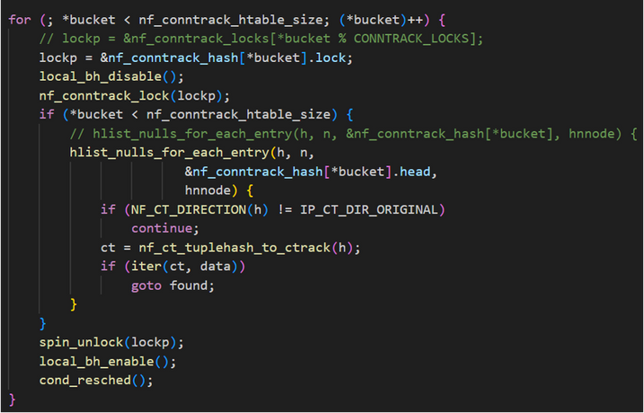
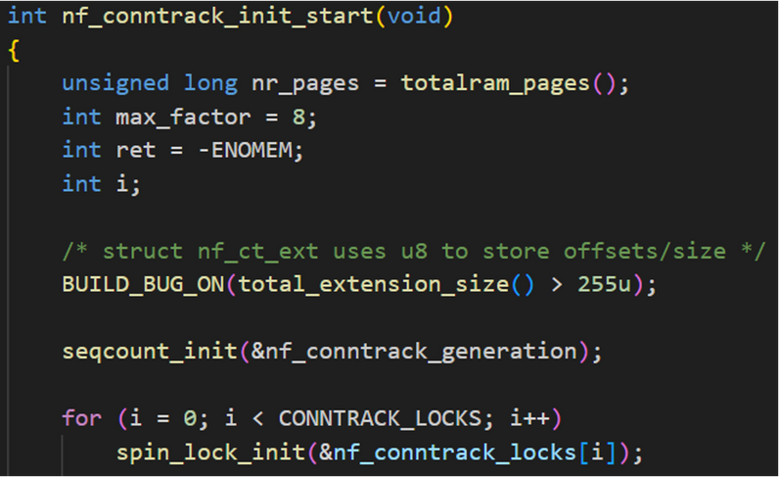
Improvement 2: Per-Bucket Lock Details
Use per-bucket locks (nf_conntrack_hash.lock) instead of the legacy global lock array (nf_conntrack_locks).
Remove initialization code related to the deprecated nf_conntrack_locks.

Slide 29
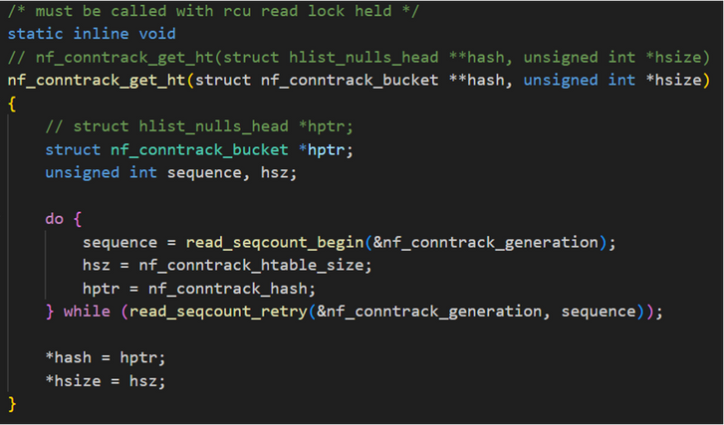
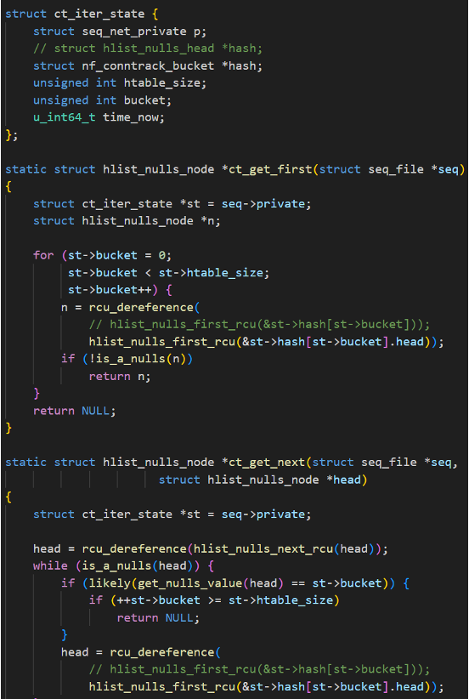
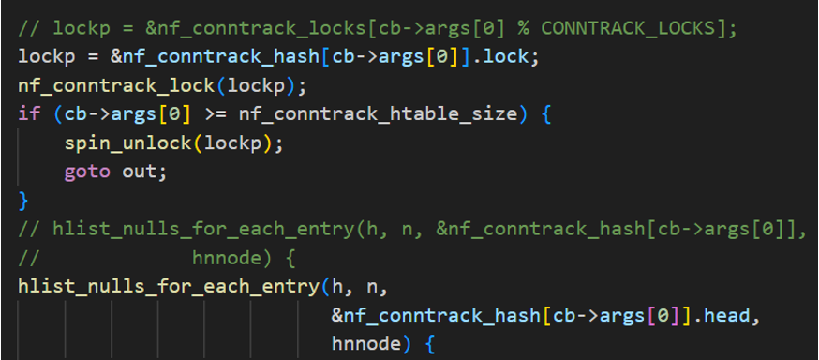
Improvement 2: Per-Bucket Lock Details
Replace occurrences of hlist_nulls_head with nf_conntrack_bucket throughout the code.
Replace nf_conntrack_locks with nf_conntrack_hash.lock (per-bucket lock)
Replace hlist_nulls_head with nf_conntrack_bucket
Update hash table access to reference the .head member of the bucket structure

Slide 30
Performance Analysis Environment (Benchmark Variables)
Measurement
Server Settings
> Disable unnecessary module loading & automatic load balancing
> IRQ Pinning: bind virtio IRQ → CPU 0
> Reduce hash table size: buckets=512, max=300,000
> Increase timeout: udp_timeout=3600
> Disable tracking bypass (ensure all traffic is tracked)
Tool : perf top
option : -C 0 -F 100 (CPU 0 only, 100Hz sampling)
Timing : When nf_conntrack_count reaches 300k and the system becomes overloaded
Client Attack Profile
Measurement Objective
> Script: maintain pktgen.sh parameters
> Unlimited fire mode: continuously generate new packets with random source IP
> Burst: 100,000 (1M packets/s firing scenario)
> Execution CPU: single-core mode fixed
Quantitatively evaluate lock contention mitigation by observing CPU usage changes in
__nf_conntrack_find_get and __nf_conntrack_confirm under high-load situations.

Slide 31
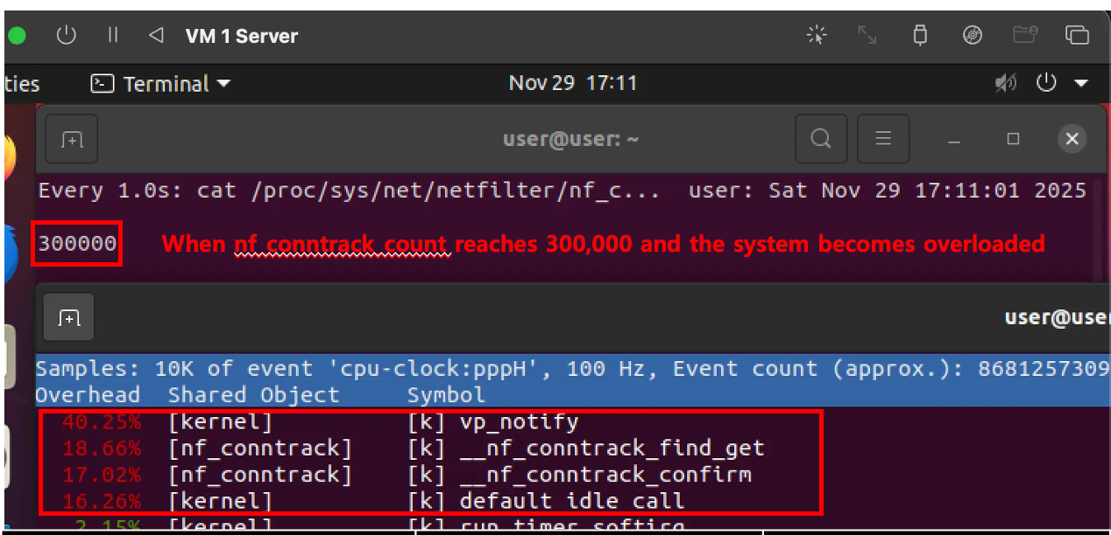
Performance Results: Dynamic Spinlock

Slide 32
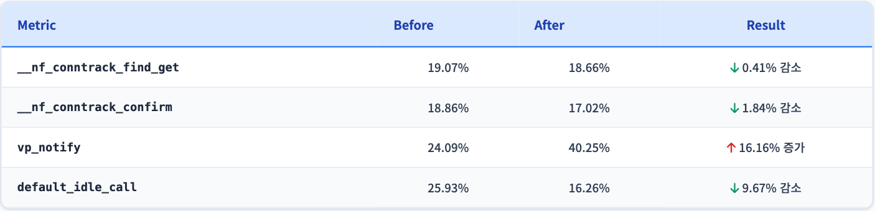
Performance Results: Dynamic Spinlock
Lock Contention Mitigation Effects
Notes (Virtualized Environment)
vp_notify increased by more than 1.6× → Longer spin waits under dynamic spinlock caused more frequent Guest ↔ Host notifications.
Lock acquisition failures → relax/yield operations in VMs lead to increased hypervisor (Host-OS) involvement.
In bare-metal environments, this overhead does not occur → greater performance gains expected on physical servers.
__nf_conntrack_confirm CPU cost decreased by 1.84% → Reduced lock contention on the connection confirmation path.
__nf_conntrack_find_get CPU cost decreased by 0.41% - → Shortened lock wait time during existing connection lookup.
Dynamically allocated locks distribute contention effectively → Overall performance improvement in key functions.

Slide 33
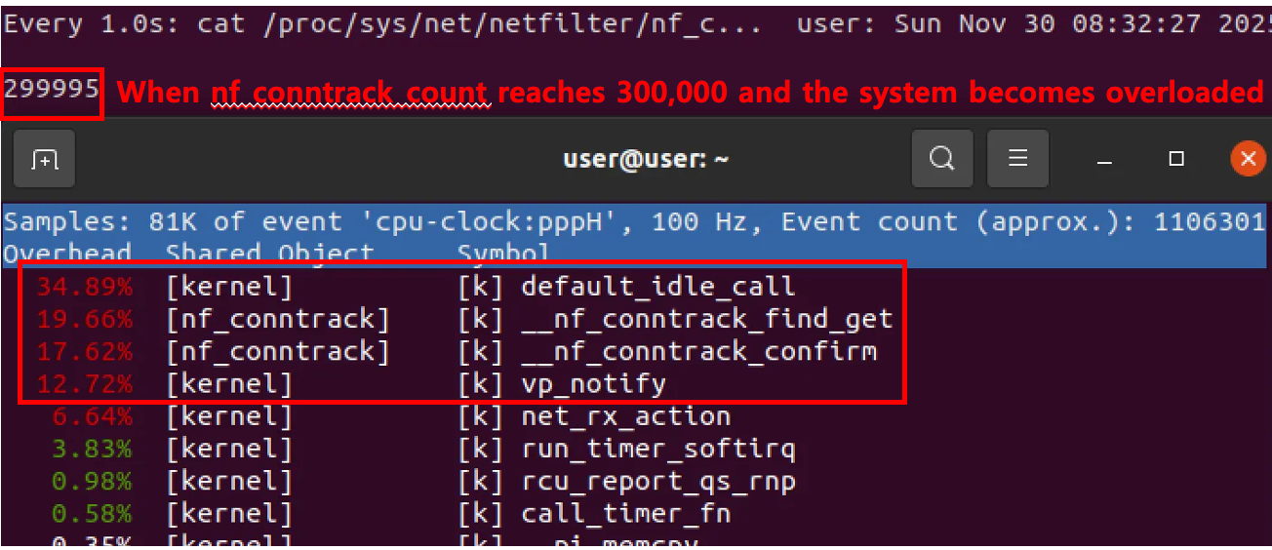
Performance Results: Per-Bucket Lock

Slide 34
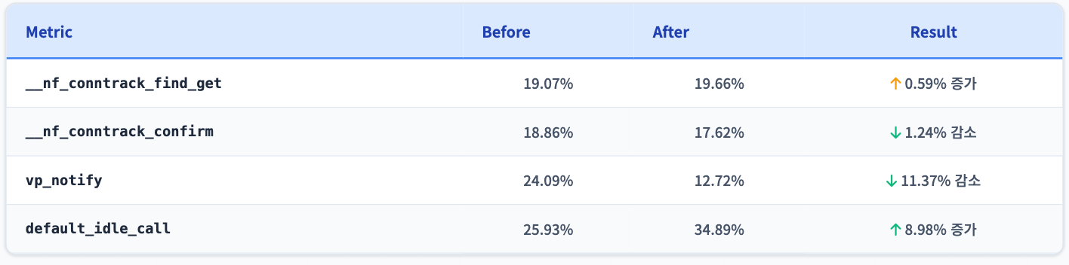
Performance Results: Per-Bucket Lock
Lock Contention Mitigation Effects
Detailed Analysis
__nf_conntrack_find_get increased by 0.59% → Due to reduced noise (e.g., vp_notify), more CPU cycles are now spent on lookup operations.
Per-bucket lock distribution improves overall system stability and reduces contention.Even in virtualized environments, performance improvement is consistent → Greater stability compared to dynamic spinlock approach.
vp_notify decreased by 11.37% → Efficient lock handling significantly reduces Guest–Host communication overhead, which was the main bottleneck in virtualized environments.
__default_idle_call increased by 8.98% → CPU resources were saved and transitioned into idle state → better system efficiency.
__nf_conntrack_confirm decreased by 1.24% → Reduced overhead during new connection confirmation → improved concurrency.

Slide 35
Performance Results: Per-Bucket Lock
Common Findings
Both methods reduce the CPU cost of __nf_conntrack_confirm, demonstrating mitigation of lock contention on the new-connection confirmation path.
Dynamic Spinlock
Per-Bucket Lock
Performance Metrics
Performance Metrics
__nf_conntrack_confirm: ↓1.84%p
__nf_conntrack_find_get: ↓0.41%p
vp_notify: ↑16.16%p
default_idle_call: ↓9.67%p
__nf_conntrack_confirm: ↓1.24%p
__nf_conntrack_find_get: ↑0.59%p
vp_notify: ↓11.37%p
default_idle_call: ↑8.98%p
Characteristics
Characteristics
Dynamically adjusts lock array size to optimize for CPU count and hash table size.
However, in virtualized environments, longer spin-waits cause increased Host-OS traps
→ significant vp_notify overhead.
→ Works efficiently on bare-metal systems.
Each bucket owns its own lock → fundamentally distributes contention.
Even in VM environments, lower vp_notify overhead yields stable performance.
Drastically reduces Guest-Host communication cost.

Slide 36
Conclusion
The primary performance bottleneck in the Netfilter/Conntrack pipeline is lock contention
Per-Bucket Lock provides the most consistent improvement
Dynamic Spinlock is suitable for physical servers
Under high-load environments, global lock array contention is a major root cause of performance degradation.
Maintains stability even in virtualized environments and offers superior lock distribution efficiency.
In VMs, increased vp_notify overhead reduces benefits,
whereas in bare-metal systems, it remains effective.

Slide 37
THANK YOU
THANK YOU
TEAM 3

